Slide 1
ELEC5620M Embedded Microprocessor System Design
Unit 3.2
Dr David Cowell Module Leader d.m.j.cowell@leeds.ac.uk
Prof Steven Freear

Slide 2
Easter break support arrangements
Initial enquiries by email… Not by MS Teams please!
ELEC5620M-Support@leeds.ac.uk or ELEC5566M-Support@leeds.ac.uk
Lab 160 open 9am to 5pm, Monday to Friday
except University Closure 28 March – 2 April 2024

Slide 3
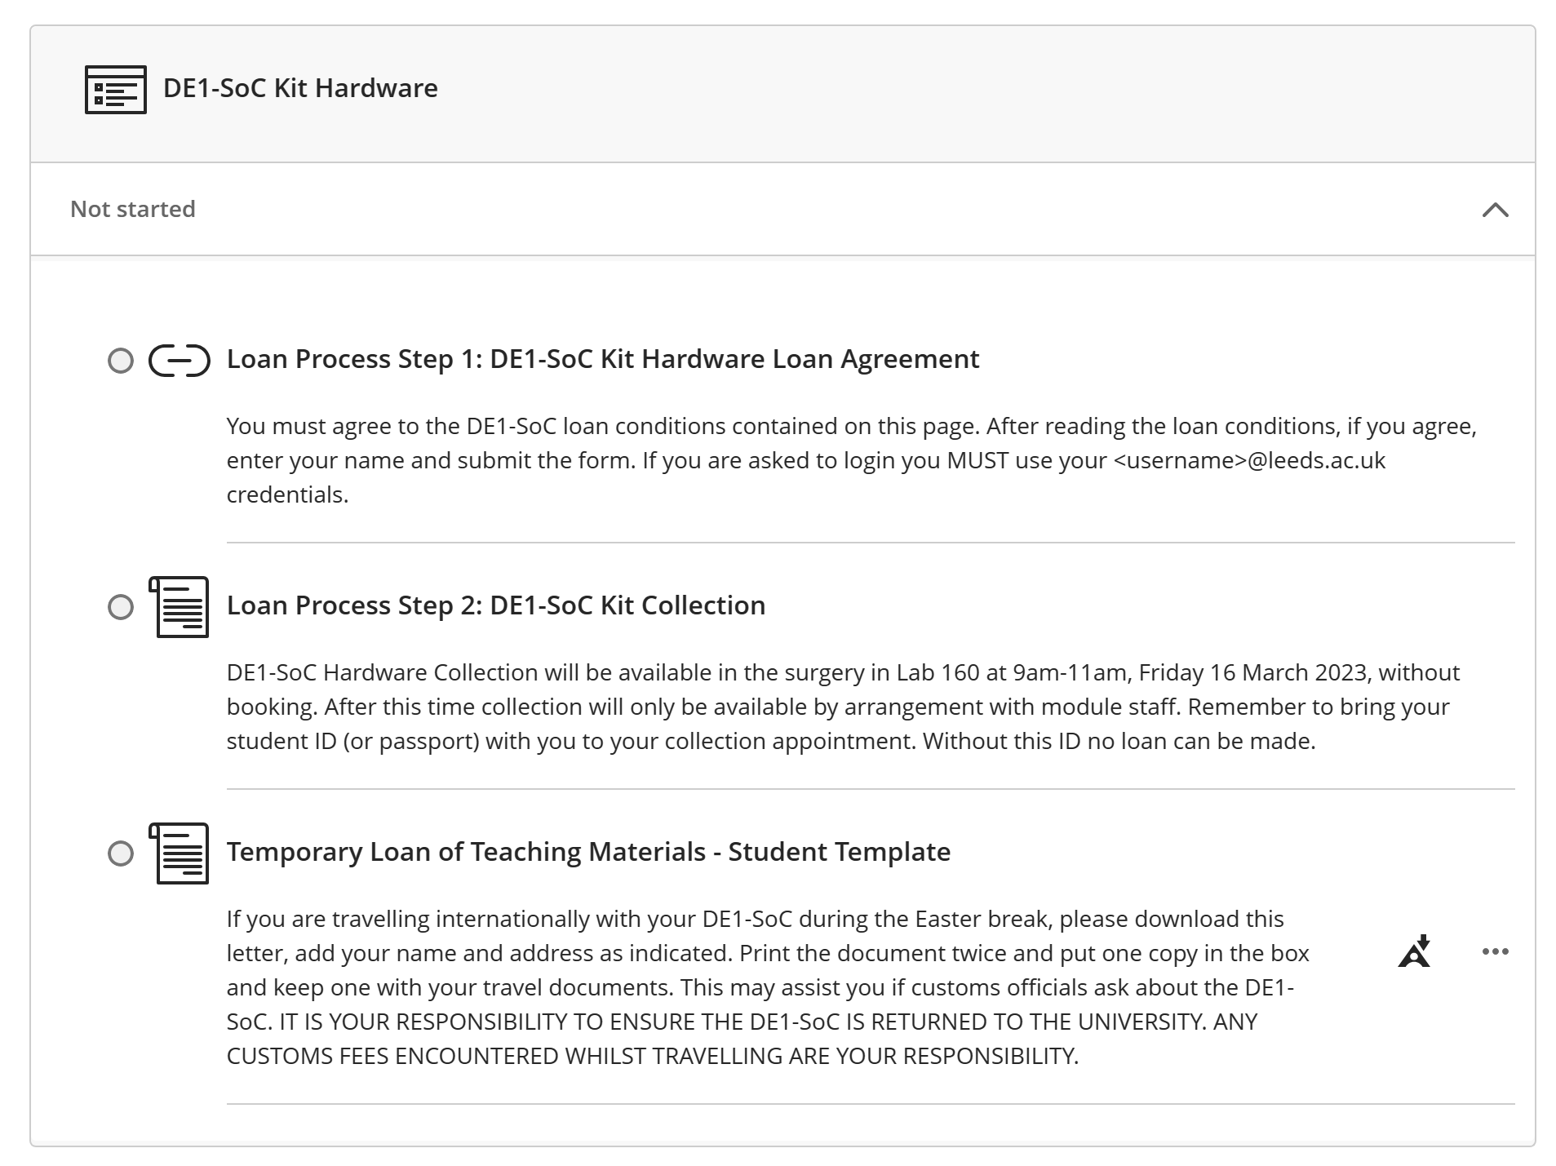
DE1-SoC Hardware and Travel

Slide 4
Mini-Project Next Steps
You will receive an email confirming your group listed today.
If correct – DO NOT REPLY.
If incorrect – REPLY IMMEDIATELY listing changes required.
Before next week, you will receive a link to a shared GitHub repository for your group.
WARNING – Group working requires communication.

Slide 5
Unit 3.2
LCD, Software Optimisation and DDR
Bitbang vs Dedicated Hardware
Software Optimisation
DDR Memory

Slide 6
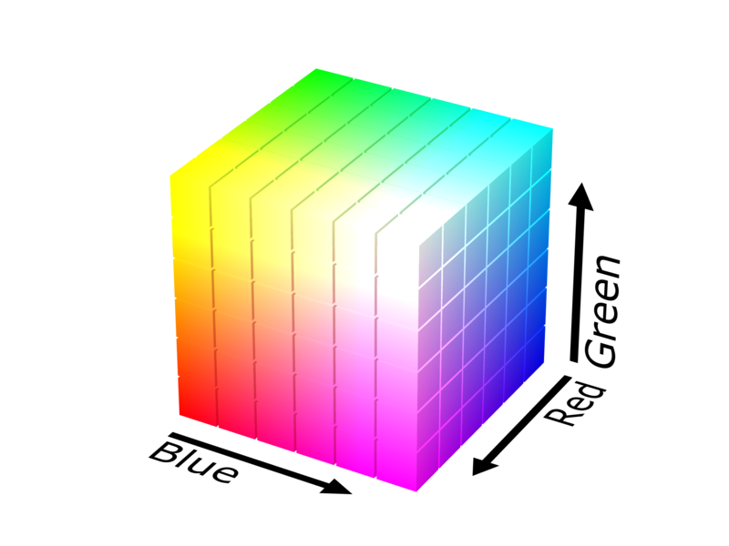

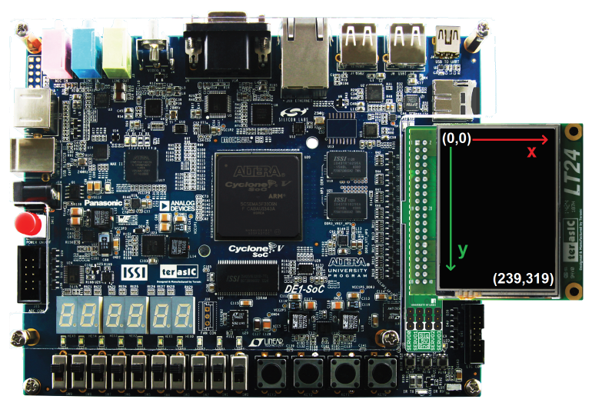
LT24 QVGA LCD
 | R |  |  |  |  | G |  |  |  |  |  | B
 | 5 |  |  |  |  | 6 |  |  |  |  |  | 5
 | 4 | 3 | 2 | 1 | 0 | 5 | 4 | 3 | 2 | 1 | 0 | 4 | 3 | 2 | 1 | 0
Black 0x0000 | 0 | 0 | 0 | 0 | 0 | 0 | 0 | 0 | 0 | 0 | 0 | 0 | 0 | 0 | 0 | 0
Blue 0x001F |  |  |  |  |  |  |  |  |  |  |  | 1 | 1 | 1 | 1 | 1
Green 0x07E0 |  |  |  |  |  | 1 | 1 | 1 | 1 | 1 | 1
Red 0xF800 | 1 | 1 | 1 | 1 | 1
Cyan 0x07FF |  |  |  |  |  | 1 | 1 | 1 | 1 | 1 | 1 | 1 | 1 | 1 | 1 | 1
Yellow 0xFFE0 | 1 | 1 | 1 | 1 | 1 | 1 | 1 | 1 | 1 | 1 | 1
Magenta 0xF81F | 1 | 1 | 1 | 1 | 1 |  |  |  |  |  |  | 1 | 1 | 1 | 1 | 1
White 0xFFFF | 1 | 1 | 1 | 1 | 1 | 1 | 1 | 1 | 1 | 1 | 1 | 1 | 1 | 1 | 1 | 1

Slide 7
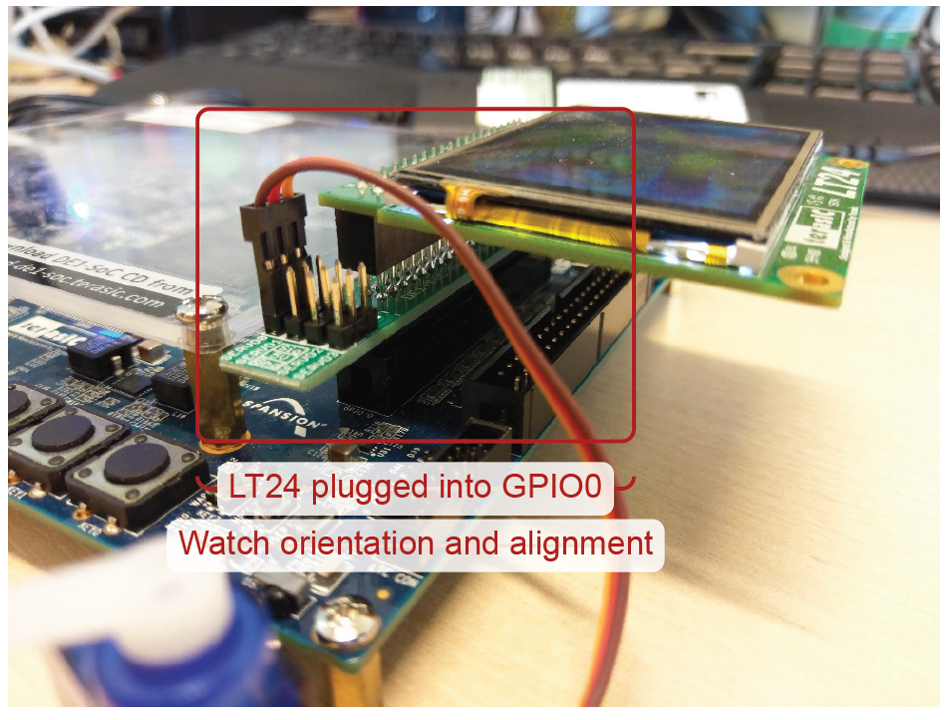
LT24 LCD Connection

Slide 8
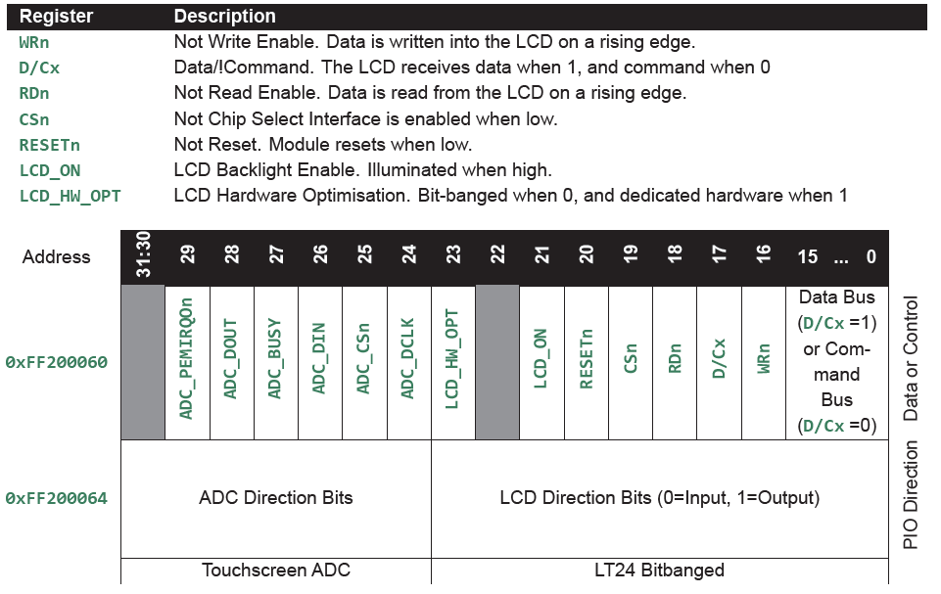
LT24 Interface Registers – Shared PIO

Slide 9
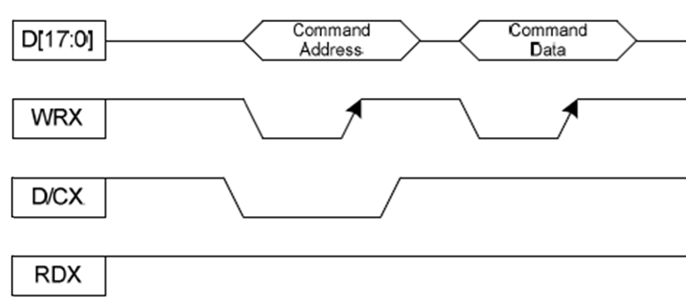
LT24 Driver IC Interface
PIO Driver
(1-15) value
WRn (16) LT24_WRn (bit<<16)
D/Cx (17) LT24_RS (bit<<17)
RDn (18) LT24_RDn (1<<18)

Slide 10
DE1SoC_LT24 Driver Bitbang (Software) Write Interface
//Function for writing to LT24 Registers (using PIO)
static void _LT24_write( PLT24Ctx_t ctx, bool isData, unsigned short value ) {
//PIO controls more than just LT24, so need to Read-Modify-Write
unsigned int regVal = ctx->cntrl[LT24_PIO_DATA]; //Read
//First we have to output the value with the LT24_WRn bit low (first cycle of write)
//Mask all bits for command and data (sets them all to 0)
regVal = regVal & ~LT24_CMDDATMASK; //Modify
//Set the data bits (unsigned value, so cast pads MSBs with 0's)
regVal = regVal | ((unsigned int)value);
if (isData) {
regVal = regVal | (LT24_RS | LT24_RDn); //For data we set the RS bit high.
} else {
regVal = regVal | ( LT24_RDn); //For command we don't set the RS bit
}
ctx->cntrl[LT24_PIO_DATA] = regVal; //Write
//Then we need to output the value again with LT24_WRn high (second cycle of write)
//Rest of regVal is unchanged, so we just OR on the LT24_WRn bit
regVal = regVal | (LT24_WRn); //Modify
ctx->cntrl[LT24_PIO_DATA] = regVal; //Write
}

Slide 11
LT24 Driver IC Interface
LT24_WRn
LT24_RS
LT24_RDn
unsigned int regVal =
ctx->cntrl[LT24_PIO_DATA]; //Read
regVal = regVal & ~LT24_CMDDATMASK;
regVal = regVal | ((unsigned int)value);
if (isData) { //Modify
regVal = regVal | (LT24_RS | LT24_RDn);
} else { //Modify
regVal = regVal | ( LT24_RDn);
}
ctx->cntrl[LT24_PIO_DATA] = regVal; //Write
regVal = regVal | (LT24_WRn); //Modify
ctx->cntrl[LT24_PIO_DATA] = regVal; //Write

Slide 12
LT24 Driver IC Interface Command Write
LT24_WRn
LT24_RS
LT24_RDn
unsigned int regVal =
ctx->cntrl[LT24_PIO_DATA]; //Read
regVal = regVal & ~LT24_CMDDATMASK;
regVal = regVal | ((unsigned int)value);
if (isData) { //Modify
regVal = regVal | (LT24_RS | LT24_RDn);
} else { //Modify
regVal = regVal | ( LT24_RDn);
}
ctx->cntrl[LT24_PIO_DATA] = regVal; //Write
regVal = regVal | (LT24_WRn); //Modify
ctx->cntrl[LT24_PIO_DATA] = regVal; //Write

Slide 13
LT24 Driver IC Interface Data Write
LT24_WRn
LT24_RS
LT24_RDn
unsigned int regVal =
ctx->cntrl[LT24_PIO_DATA]; //Read
regVal = regVal & ~LT24_CMDDATMASK;
regVal = regVal | ((unsigned int)value);
if (isData) { //Modify
regVal = regVal | (LT24_RS | LT24_RDn);
} else { //Modify
regVal = regVal | ( LT24_RDn);
}
ctx->cntrl[LT24_PIO_DATA] = regVal; //Write
regVal = regVal | (LT24_WRn); //Modify
ctx->cntrl[LT24_PIO_DATA] = regVal; //Write

Slide 14
LT24 Interface Registers – Shared PIO

Slide 15
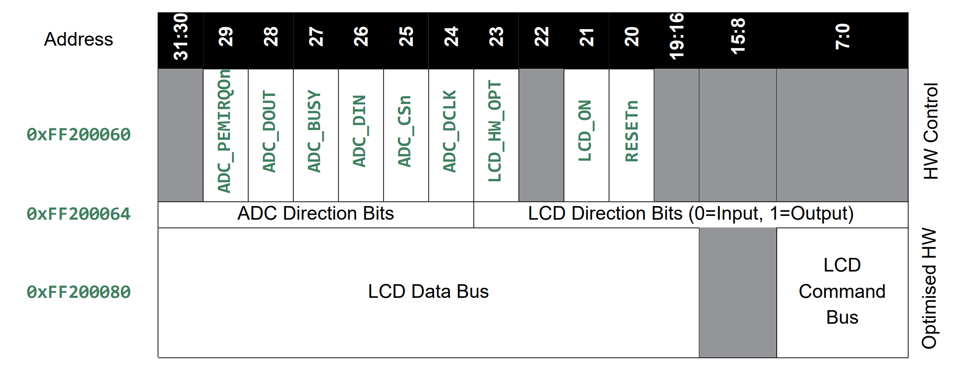
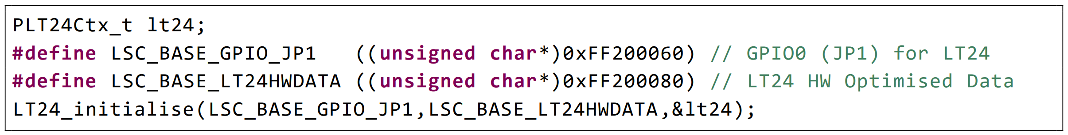
LT24 LCD Hardware Optimised Interface

Slide 16
static void _LT24_write( PLT24Ctx_t ctx, bool isData, unsigned short value ) {
if (ctx->hwOpt) {
// Use data interface in hwOpt mode
if (isData) {
ctx->data[LT24_DEDDATA] = value;
} else {
ctx->data[LT24_DEDCMD ] = value;
}
} else {
//PIO controls more than just LT24, so need to Read-Modify-Write
//First we have to output the value with the LT24_WRn bit low (first cycle of write)
//Read
unsigned int regVal = ctx->cntrl[LT24_PIO_DATA];
//Modify
//Mask all bits for command and data (sets them all to 0)
regVal = regVal & ~LT24_CMDDATMASK;
//Set the data bits (unsigned value, so cast pads MSBs with 0's)
regVal = regVal | ((unsigned int)value);
if (isData) {
//For data we set the RS bit high.
regVal = regVal | (LT24_RS | LT24_RDn);
} else {
//For command we don't set the RS bit
regVal = regVal | (LT24_RDn);
}
//Write
ctx->cntrl[LT24_PIO_DATA] = regVal;
//Then we need to output the value again with LT24_WRn high (second cycle of write)
//Rest of regVal is unchanged, so we just or on the LT24_WRn bit
regVal = regVal | (LT24_WRn);
//Write
ctx->cntrl[LT24_PIO_DATA] = regVal;
}
}

Slide 17
static void _LT24_write( PLT24Ctx_t ctx, bool isData, unsigned short value ) {
if (ctx->hwOpt) {
// Use data interface in hwOpt mode
if (isData) {
ctx->data[LT24_DEDDATA] = value;
} else {
ctx->data[LT24_DEDCMD ] = value;
}
} else {
//PIO controls more than just LT24, so need to Read-Modify-Write
//First we have to output the value with the LT24_WRn bit low (first cycle of write)
//Read
unsigned int regVal = ctx->cntrl[LT24_PIO_DATA];
//Modify
//Mask all bits for command and data (sets them all to 0)
regVal = regVal & ~LT24_CMDDATMASK;
//Set the data bits (unsigned value, so cast pads MSBs with 0's)
regVal = regVal | ((unsigned int)value);
if (isData) {
//For data we set the RS bit high.
regVal = regVal | (LT24_RS | LT24_RDn);
} else {
//For command we don't set the RS bit
regVal = regVal | (LT24_RDn);
}
//Write
ctx->cntrl[LT24_PIO_DATA] = regVal;
//Then we need to output the value again with LT24_WRn high (second cycle of write)
//Rest of regVal is unchanged, so we just or on the LT24_WRn bit
regVal = regVal | (LT24_WRn);
//Write
ctx->cntrl[LT24_PIO_DATA] = regVal;
}
}

Slide 18
LT24 Write Hardware Optimised
static void _LT24_write( PLT24Ctx_t ctx, bool isData, unsigned short value ) {
if (ctx->hwOpt) {
// Use data interface in hwOpt mode
if (isData) {
ctx->data[LT24_DEDDATA] = value;
} else {
ctx->data[LT24_DEDCMD ] = value;
}
}
}
// Driver context
typedef struct {
// Context Header
DrvCtx_t header;
// Context Body
volatile unsigned int* cntrl;
volatile unsigned short* data;
bool hwOpt;
} LT24Ctx_t, *PLT24Ctx_t;
//LT24 Dedicated Address Offsets
#define LT24_DEDCMD (0x00/sizeof(unsigned short))
#define LT24_DEDDATA (0x02/sizeof(unsigned short))

Slide 19
Unit 3.2
LCD, Software Optimisation and DDR
Bitbang vs Dedicated Hardware
Software Optimisation
DDR Memory

Slide 20
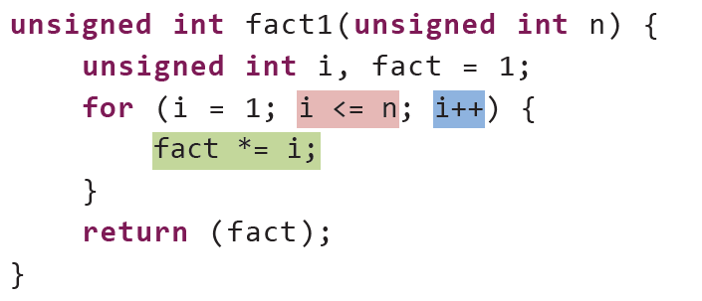
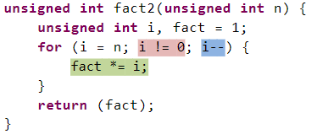
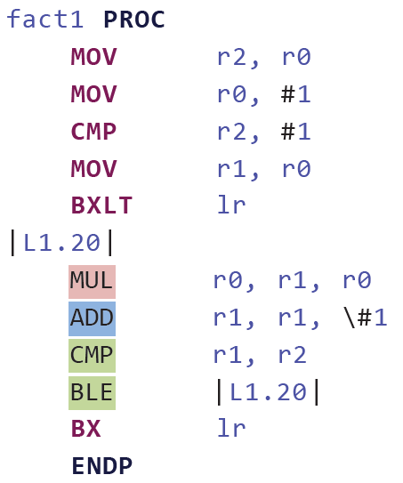
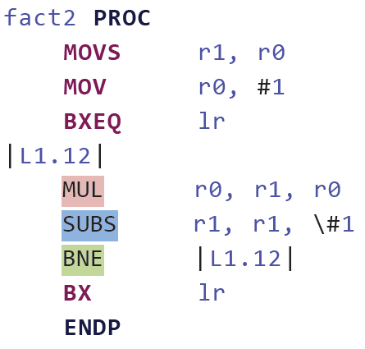
Compiler Optimisations Decrementing Loops and Zero Termination

Slide 21
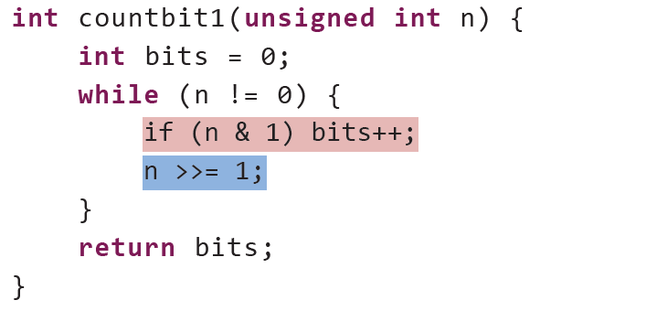
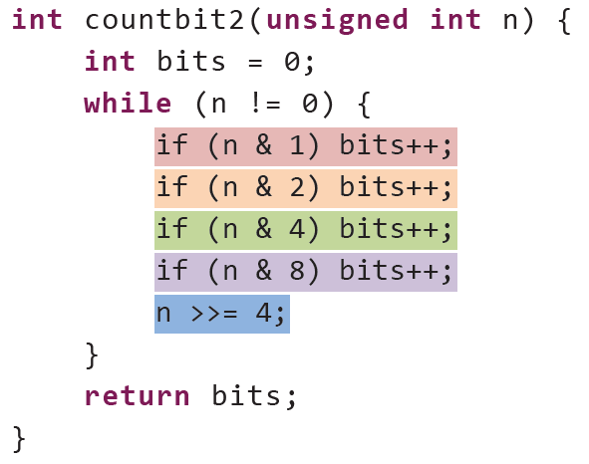
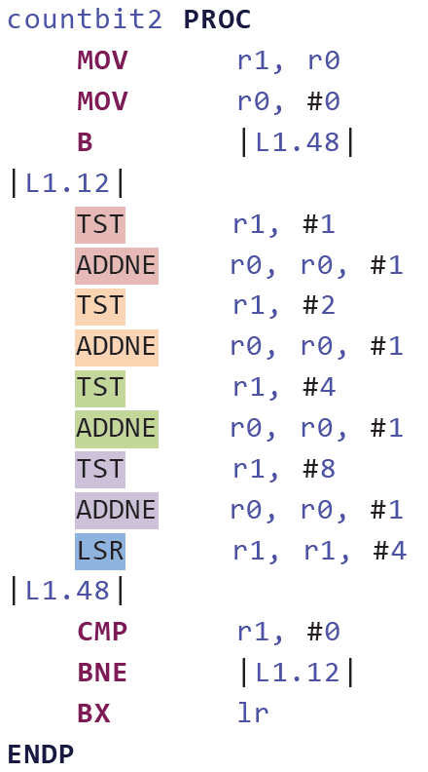
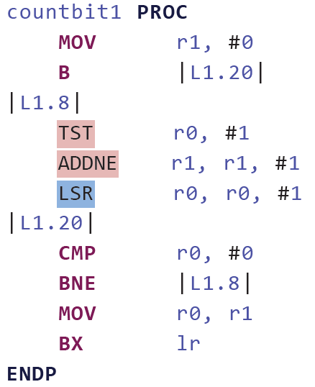
Compiler Optimisation Loop unrolling

Slide 22
Compiler Optimisations
The Arm® Compiler for Embedded User Guide Version 6.19 specifies the following levels of optimization available when compiling source files:
-O0 — disables all optimizations. This optimization level is the default. Using -O0 results in a faster compilation and build time, but produces slower code than the other optimization levels. Code size and stack usage are significantly higher at -O0 than at other optimization levels. The generated code closely correlates to the source code, but significantly more code is generated, including dead code.
-O1 — enables the core optimizations in the compiler. This optimization level provides a good debug experience with better code quality than -O0. Also the stack usage is improved over -O0.Arm recommends this option for a good debug experience.
-O2 — is a higher optimization for performance compared to -O1. It adds few new optimizations, and changes the heuristics for optimizations compared to -O1. This level is the first optimization level at which the compiler might automatically generate vector instructions. It also degrades the debug experience, and might result in an increased code size compared to -O1.
-O3 — is a higher optimization for performance compared to -O2. This optimization level enables optimizations that require significant compile-time analysis and resources, and changes the heuristics for optimizations compared to -O2. -O3 instructs the compiler to optimize for the performance of generated code and disregard the size of the generated code, which might result in an increased code size. It also degrades the debug experience compared to -O2.

Slide 23
Compiler Optimisations
-Os — aims to provide high performance without a significant increase in code size. Depending on your application, the performance provided by -Os might be similar to -O2 or -O3.
-Oz — aims to provide reduced code size without using Link-Time Optimization (LTO). Arm recommends this option for best code size if LTO is not appropriate for your application. This optimization level degrades the debug experience compared to -O1.
-Omin — aims to provide smaller code size than -Oz, by using a subset of LTO functionality. You might be able to achieve even smaller code size using -Oz with LTO enabled.
-Ofast — performs optimizations from level -O3, including those optimizations performed with the armclang option -ffast-math. This level also performs other aggressive optimizations that might violate strict compliance with language standards. This level degrades the debug experience, and might result in increased code size compared to -O3.
-Omax — performs maximum optimization, and specifically targets performance optimization. It enables all the optimizations from level -Ofast, together with LTO. At this optimization level, Arm Compiler for Embedded might violate strict compliance with language standards. Use this optimization level for the fastest performance. This level degrades the debug experience, and might result in increased code size compared to -Ofast.

Slide 24
Optimisation Differe
Optimization level -O1
The differences when using -O1, as compared to -O0 are:
Optimizations are enabled, which might reduce the fidelity of debug information.
Inlining is enabled, meaning backtraces might not give the stack of open function activations that you might expect from reading the source.
If the result is not needed, a function with no side-effects might not be called in the expected place, or might be omitted.
Values of variables might not be available within their scope after they are no longer used. For example, their stack location might have been reused.
Optimization level -O2
The differences when using -O2 as compared to -O1 are:
The threshold at which the compiler believes that it is profitable to inline a call site might increase.
The amount of loop unrolling that is performed might increase.
Vector instructions might be generated for simple loops and for correlated sequences of independent scalar operations.
The creation of vector instructions can be inhibited with the armclang command-line option -fno-vectorize.
https://developer.arm.com/documentation/100748/0619/Using-Common-Compiler-Options/Selecting-optimization-options

Slide 25
Optimization Goals
Optimization goal | Useful optimization levels
Better correlation between source code and generated code | -O0 (no optimization)
Faster compile and build time | -O0 (no optimization)
Good debug experience without code bloat | -O1
Faster performance | -O2, -O3, -Ofast, -Omax
Smaller code size | -Oz, -Omin
Balanced code size reduction and fast performance | -Os
https://developer.arm.com/documentation/100748/0619/Using-Common-Compiler-Options/Selecting-optimization-options

Slide 26
3-2-DisplayTest Faster performance -O3
'Building file: ../main.c'
'Invoking: Arm C Compiler for Embedded 6'
armclang.exe --target=arm-arm-none-eabi -mcpu=cortex-a9 -mfpu=none -mfloat-abi=soft -marm -I"C:\Users\eendmjc\Workspace\ELEC5620M-Resources\Drivers" -O3 -g -mno-unaligned-access -MD -MP -c -o "main.o" "../main.c“
'Finished building: ../main.c'
==============================================================================
Code (inc. data) RO Data RW Data ZI Data Debug
7372 348 120 396 65900 40542 Grand Totals
7372 348 120 396 65900 40542 ELF Image Totals
7372 348 120 396 0 0 ROM Totals
==============================================================================
Total RO Size (Code + RO Data) 7492 ( 7.32kB)
Total RW Size (RW Data + ZI Data) 66296 ( 64.74kB)
Total ROM Size (Code + RO Data + RW Data) 7888 ( 7.70kB)
==============================================================================

Slide 27
3-2-DisplayTest Balanced code size reduction and fast performance -Os
'Building file: ../main.c'
'Invoking: Arm C Compiler for Embedded 6'
armclang.exe --target=arm-arm-none-eabi -mcpu=cortex-a9 -mfpu=none -mfloat-abi=soft -marm -I"C:\Users\eendmjc\Workspace\ELEC5620M-Resources\Drivers" -Os -g -mno-unaligned-access -MD -MP -c -o "main.o" "../main.c“
'Finished building: ../main.c'
==============================================================================
Code (inc. data) RO Data RW Data ZI Data Debug
6792 372 96 396 65900 37866 Grand Totals
6792 372 96 396 65900 37866 ELF Image Totals
6792 372 96 396 0 0 ROM Totals
==============================================================================
Total RO Size (Code + RO Data) 6888 ( 6.73kB)
Total RW Size (RW Data + ZI Data) 66296 ( 64.74kB)
Total ROM Size (Code + RO Data + RW Data) 7284 ( 7.11kB)
==============================================================================
Smaller Code – Yes
but size vs speed?
Need to benchmark!

Slide 28
Memory Performance On Chip RAM (OCRAM) vs Double Data Rate (DDR)
; First FPGA On-Chip RAM starts at a base of 0xC0000000. RO/RW space runs for 64kB
FPGA_OCRAM 0xC0000000 0x10000
{
; Application code starts at bottom of FPGA On-Chip RAM
APP_CODE +0
{
*(vector_table,+FIRST) ; Vector Table must come first.
*(+RO)
}
; RW/ZI data starts after APP_CODE. NOCOMPRESS means that the data is
; uncompressed which is vital to allow warm reset to succeed
APP_DATA +0 NOCOMPRESS
{
*(+RW,+ZI)
}
}
; The APP_CODE and APP_DATA must fit within FPGA OCRAM.
; An Error will be given if total usage exceeds memory.
; Stack placed in main On-Chip RAM, filling the 64kB of RAM.
OCRAM 0xFFFF0000 0x10000
{
; Stack and heap comes after and is empty.
; Heap grows up, stack grows down.
ARM_LIB_STACKHEAP +0 EMPTY 0xFB00
{}
; IRQ routine stacks
; (five 0x100 regions, one for each irq processor mode)
IRQ_STACKS +0 EMPTY 0x500
{ }
}
; DDR3 RAM for HPS spans from 0x01000040 to 0x40000000 (top is at 1GB point). Lower half used for RO/RW/ZI
DDR 0x01000040 0x1EFFFFC0
{
; Application code starts at start of DDR (preloader entry address)
APP_CODE +0
{
*(vector_table,+FIRST) ; Vector Table must come first.
*(+RO)
}
; RW/ZI data starts after APP_CODE. NOCOMPRESS means that the data is
; uncompressed which is vital to allow warm reset to succeed
APP_DATA +0 NOCOMPRESS
{
*(+RW,+ZI)
}
}
; The APP_CODE, and APP_DATA must fit within DDR. An Error will be given if total
; usage exceeds memory
; DDR3 for HPS spans from 0x01000040 to 0x40000000 (top is at 1GB point). Stack is upper half.
DDR_STACK 0x20000000 0x20000000
{
; Stack and heap comes after and is empty.
; Heap grows up, stack grows down.
ARM_LIB_STACKHEAP +0 EMPTY 0x1FFFFB00
{}
; IRQ routine stacks
; (five 0x100 regions, one for each irq processor mode)
IRQ_STACKS +0 EMPTY 0x500
{ }
}

Slide 29
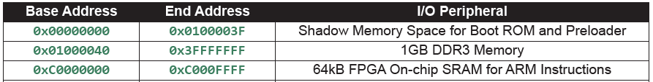
Memory Performance On Chip RAM (OCRAM) vs Double Data Rate (DDR)
; First FPGA On-Chip RAM starts at a base of 0xC0000000. RO/RW space runs for 64kB
FPGA_OCRAM 0xC0000000 0x10000
{
; Application code starts at bottom of FPGA On-Chip RAM
APP_CODE +0
{
*(vector_table,+FIRST) ; Vector Table must come first.
*(+RO)
}
; RW/ZI data starts after APP_CODE. NOCOMPRESS means that the data is
; uncompressed which is vital to allow warm reset to succeed
APP_DATA +0 NOCOMPRESS
{
*(+RW,+ZI)
}
}
; The APP_CODE and APP_DATA must fit within FPGA OCRAM.
; An Error will be given if total usage exceeds memory.
; Stack placed in main On-Chip RAM, filling the 64kB of RAM.
OCRAM 0xFFFF0000 0x10000
{
; Stack and heap comes after and is empty.
; Heap grows up, stack grows down.
ARM_LIB_STACKHEAP +0 EMPTY 0xFB00
{}
; IRQ routine stacks
; (five 0x100 regions, one for each irq processor mode)
IRQ_STACKS +0 EMPTY 0x500
{ }
}
; DDR3 RAM for HPS spans from 0x01000040 to 0x40000000 (top is at 1GB point). Lower half used for RO/RW/ZI
DDR 0x01000040 0x1EFFFFC0
{
; Application code starts at start of DDR (preloader entry address)
APP_CODE +0
{
*(vector_table,+FIRST) ; Vector Table must come first.
*(+RO)
}
; RW/ZI data starts after APP_CODE. NOCOMPRESS means that the data is
; uncompressed which is vital to allow warm reset to succeed
APP_DATA +0 NOCOMPRESS
{
*(+RW,+ZI)
}
}
; The APP_CODE, and APP_DATA must fit within DDR. An Error will be given if total
; usage exceeds memory
; DDR3 for HPS spans from 0x01000040 to 0x40000000 (top is at 1GB point). Stack is upper half.
DDR_STACK 0x20000000 0x20000000
{
; Stack and heap comes after and is empty.
; Heap grows up, stack grows down.
ARM_LIB_STACKHEAP +0 EMPTY 0x1FFFFB00
{}
; IRQ routine stacks
; (five 0x100 regions, one for each irq processor mode)
IRQ_STACKS +0 EMPTY 0x500
{ }
}

Slide 30
Tasks
Benchmark Software Bitbang vs Dedicated HW interface.
Benchmark Onchip vs DDR RAM.
Explore compiler optimisations – perform debugging to find impact of increased optimisation.
Explore driver structure in conjunction with the LCD driver datasheets in Learning Resources.

Slide 31
Questions?

